Slide 1
In each video, a random field is applied to a spin, resulting in random evolution of the spin (calculated with the Bloch equations).
The left plot (green vector) shows a bond with randomly changing orientation (bound to small-angle reorientation). The correlation time (that is, the inverse of the rate) is varied, having a long correlation time in the first plot, short correlation time in the second, and intermediate correlation time in the third
The middle plot shows the magnetization in the lab frame (blue vector), and the direction of the random field in the xy-plane (red)
The right plot shows the same, but in the rotating frame
You should notice that the magnetization vector moves the most at the intermediate correlation time. The correlation time approximately matches the Larmor frequency of the spin, resulting in efficient relaxation. This matching of correlation time to resonance frequency allows NMR to be sensitive to not only amplitude of dynamics, but also timescale. This example illustrates T₁ relaxation.

Slide 2
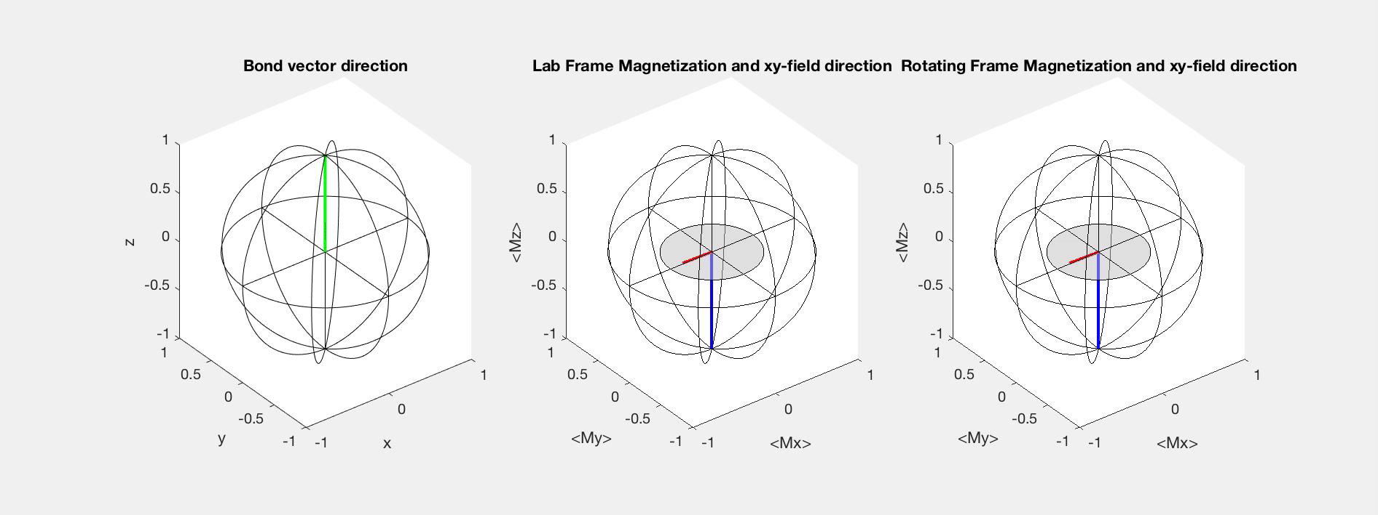
Influence of (slow) random process
Long correlation time, τc>>1/ω₀

Slide 3
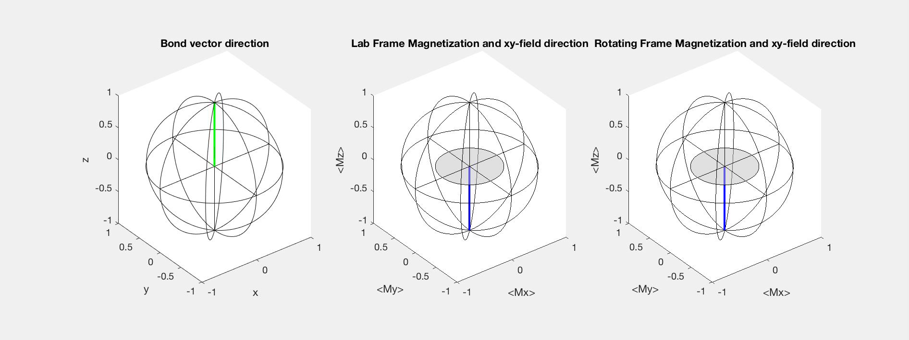
Influence of (fast) random process
Short correlation time, τc<<1/ω₀

Slide 4
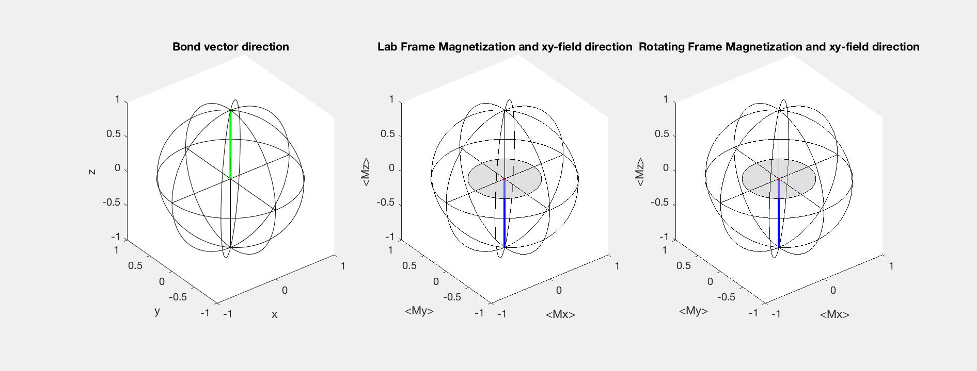
Influence of (intermediate) random process
Intermediate correlation time, 1/τc ≈ ω₀

Slide 5
In the last video, the intermediate timescale motion is applied, but now to 20 different spins (blue). The result is that all magnetization vectors end up moving in different directions. Then, the total magnetization (red, which is what can be observed experimentally) gradually averages towards zero.
Note, in a real system, the average magnetization goes towards thermal equilibrium rather than zero.

Slide 6
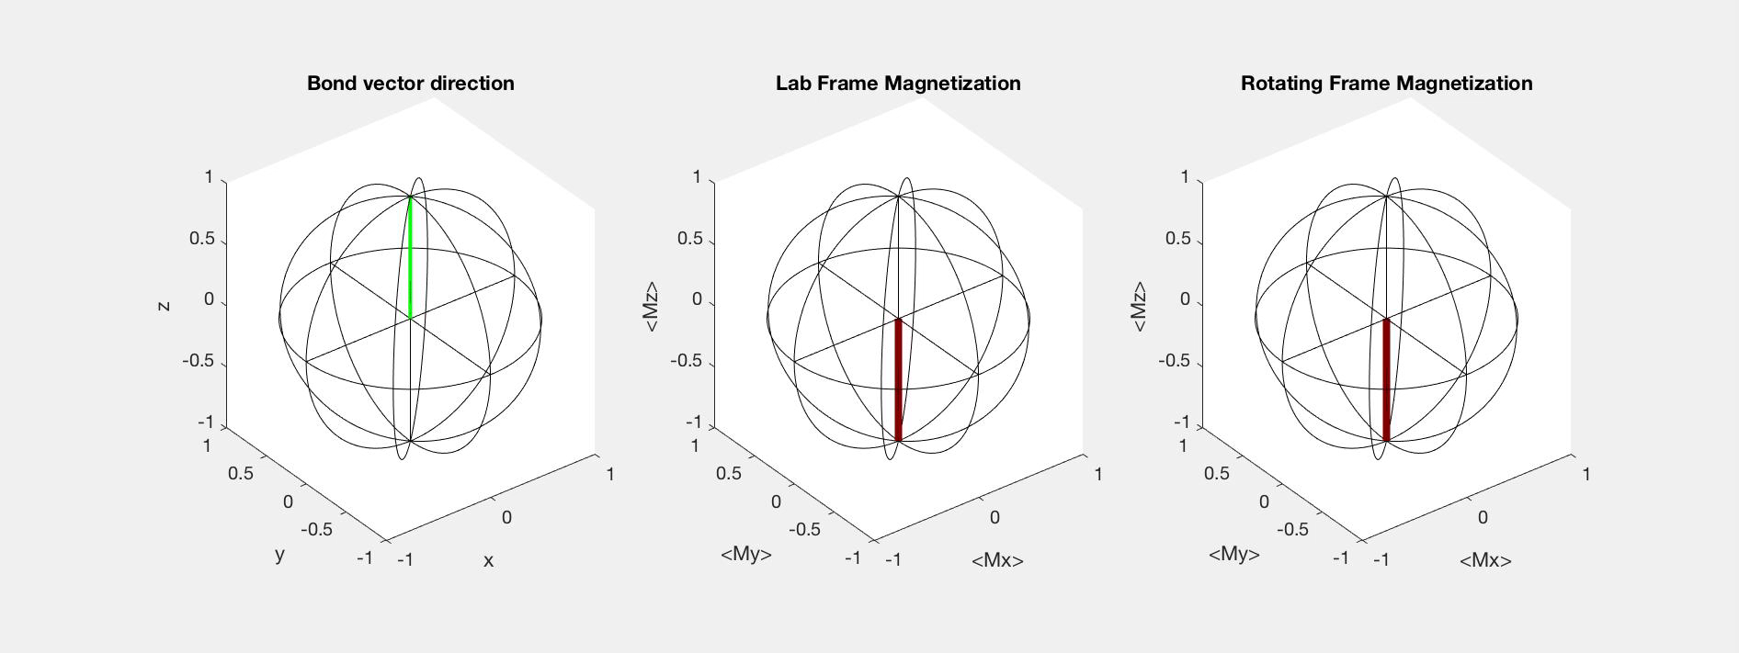
Net results

